Slide 1
MOOCs Recommender Based on Learning Style

Slide 2
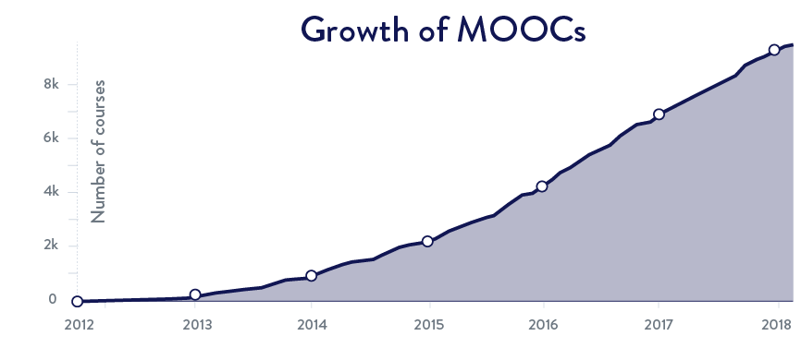
Background
“Massive Open Online Courses” – New Revolution in e-Learning
81M
9.4K
800+
Source: www.class-central.com/report/mooc-stats-2016/
Source: www.class-central.com/report/mooc-stats-2017/

Slide 3
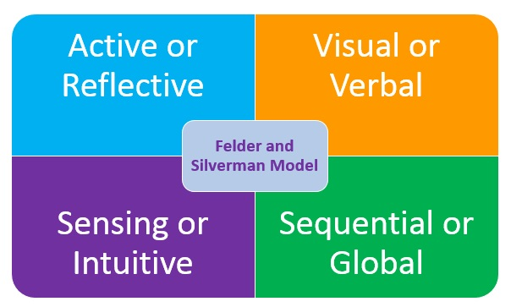

Learning Styles
Different people learn in different ways
Felder and Silverman Learning Style Model is adopted
Classifies learning styles into four dimensions and identifies two types of learner for each dimension

Slide 4








Research Problem

Slide 5




Existing Systems

Slide 6
Comparing Features
Features | Class Central | MyMooc | MoocLab | Coursetalk | Proposed System
Learner’s Learning Styles
Video Production Style of MOOCs
Audio Accent Filter
Filter Based on Specific Keywords
User Profile and Dashboard

Slide 7


Proposed Solution
Correlate MOOCs and Learning Styles

Slide 8

Proposed Solution Contd ..
Personalization
Advanced Search Engine
Recommend most suitable MOOCs based on Learning Style of Learner
User can filter MOOCs using advanced factors

Slide 9
General Objectives
Unified Platform for MOOCs
User Friendly Interfaces
Recommendation based on Learning Styles
Ease the process of learning
Explore New Technologies

Slide 10
Specific Objectives
Classification of Video Production Style
Topic Modeling of Transcripts of video lectures
Measure Complexity of Transcripts
Web Scraping and Crawling
Speaker’s English Accent Classification
Correlating MOOCs and Learning Styles
Retrieval of MOOCs based on user filters
Recommending most suitable learning resources

Slide 11
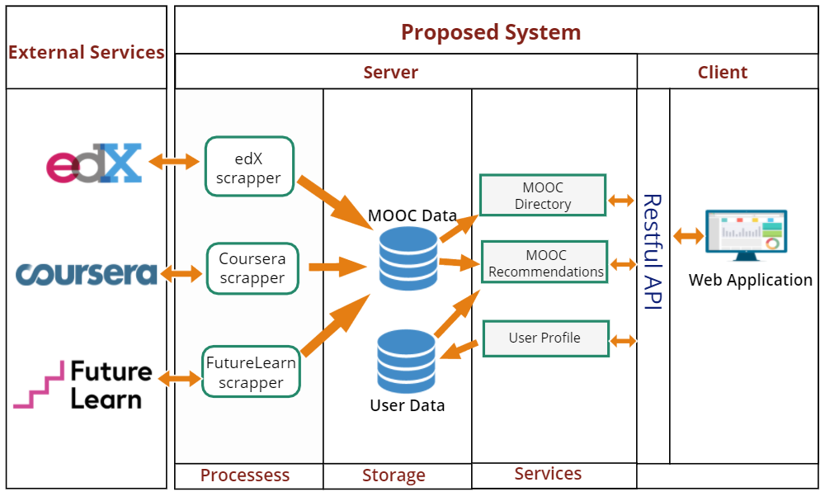
System Architecture

Slide 12
Core Modules
Web Scraping and Crawling
Video Style CLassification
Transcript Analysis
Learner Profile Modeling

Slide 13
Web Scraping / Crawling
Resources
User
Reviews
Video Lectures
Comments
MOOCs
Course Information
Quizzes
Transcripts

Slide 14


Web Scraping / Crawling Contd ..
Extract Information
E

Slide 15
Topic Modeling
Discovering abstract “topics” in the transcript
Used to search MOOCs based on specific keywords
Cluster of Words / Topics
Transcripts
Topic Modeling
Frequency of Words
Distribution of Topics

Slide 16
Transcript Complexity
Discover Lexical Complexity of the transcripts
Discover Syntactic Complexity of the transcripts
Lexical Complexity
Used to filter MOOCs based on learner’s preference
Transcripts
Linguistic Complexity
Syntactic Complexity

Slide 17
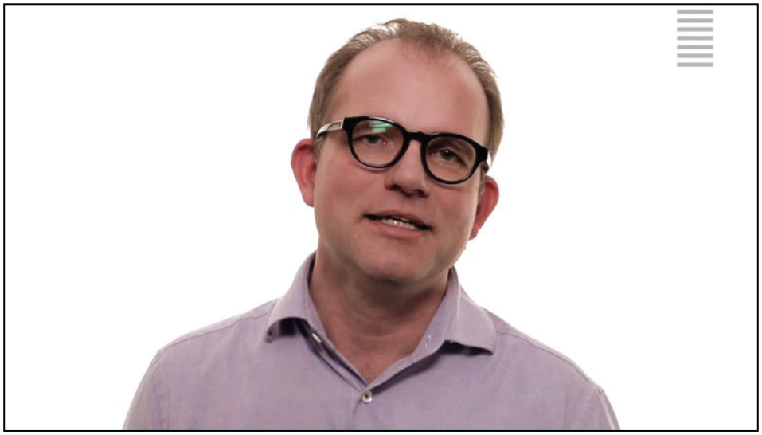
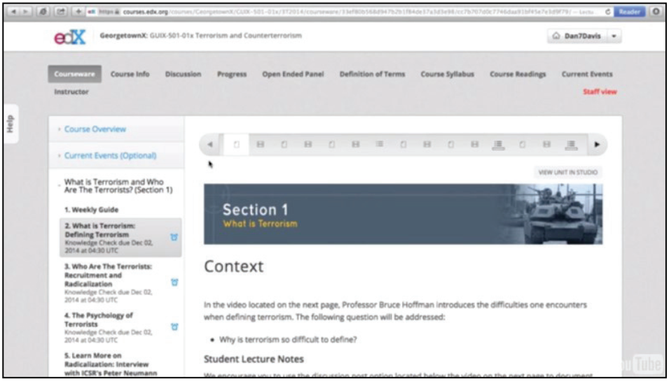
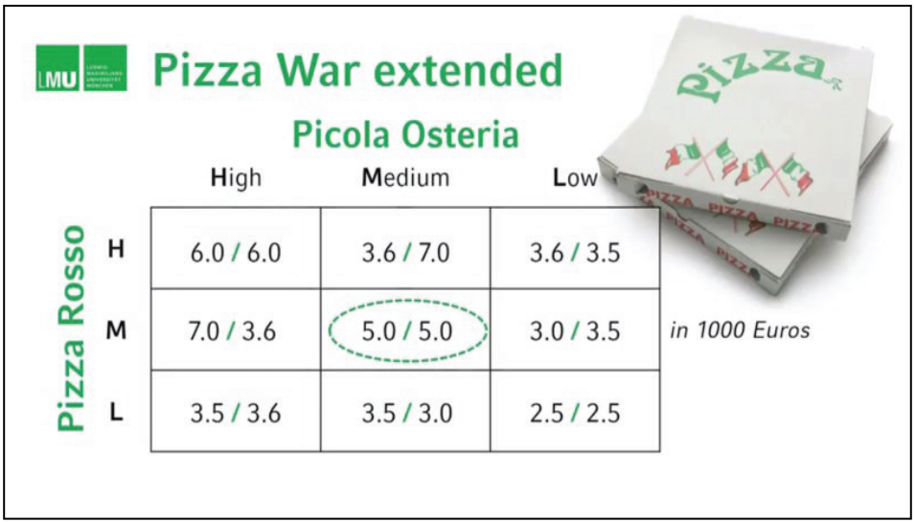
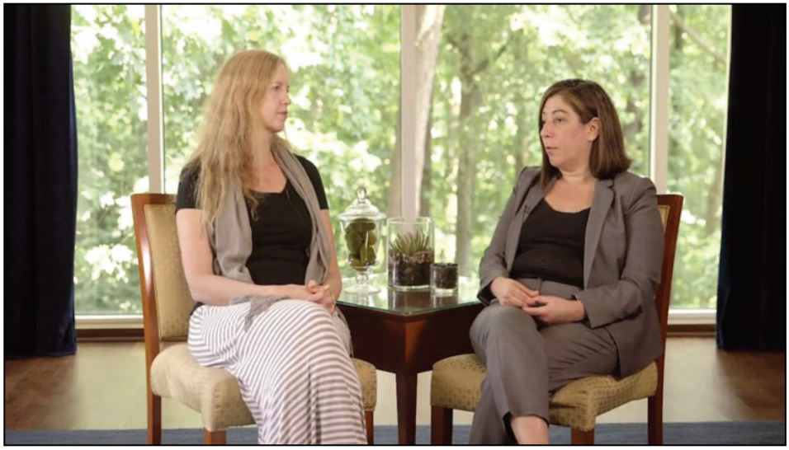
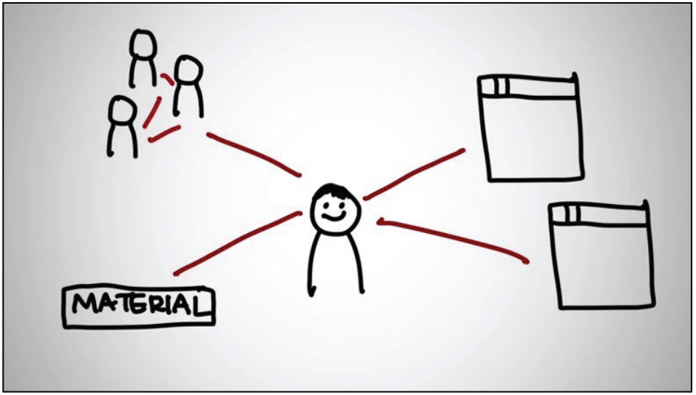
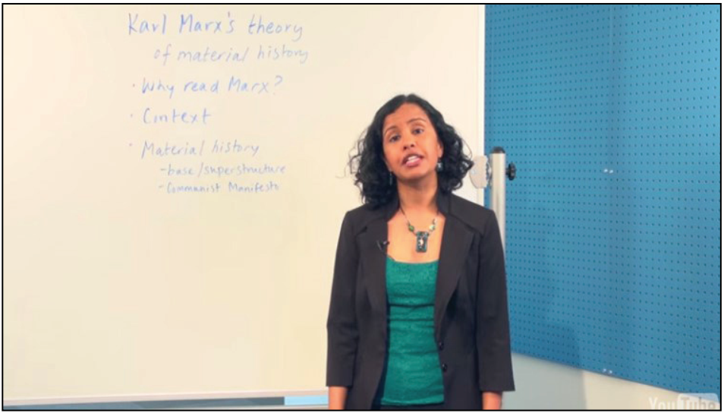
Video Style Classification
Different Video Lecture Styles across various platforms
Cluster of Words / Topics
Talking Head
Tutorial / Demonstration
Presentation Slide with Voice Over
Conversation
Animation
Whiteboard
Source: A. Hansch et al., “Video and Online Learning: Critical Reflections and Findings from the Field,” SSRN Electron. J., Mar. 2015.

Slide 18
Video Style Classification Contd ..
MOOC Videos are composed of several video production styles
Identify what % of a specific video style is contained in a video lecture
Calculate the aggregate for overall course and store in database
Procedure :
Split the video into frames
Use Convolutional Neural Network to classify the frames

Slide 19
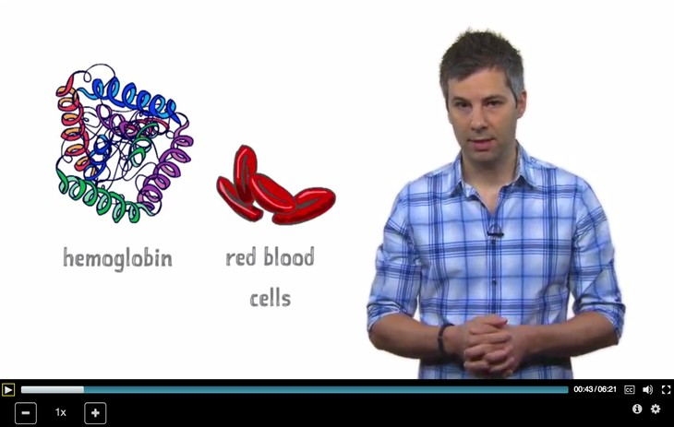

Video Style Classification Contd ..
Image
Frames
Cluster of Words / Topics

Slide 20

Learner Profile Modeling
MOOCs are assigned weight for each learning style (Mapping)
Mapping is based on Literature Review
Identify Learner’s Learning Style using ILS questionnaire
Recommend MOOCs based on assigned weight and learner’s learning style

Slide 21


Learner Profile Modeling Contd ..
Cluster of Words / Topics
Advanced filters to search MOOCs across various platforms
Interactive Dashboard and Client Application

Slide 22




Tools and Technologies

Slide 23

Users
Cluster of Words / Topics
Anyone who wants to “Learn” using MOOCs

Slide 24

Business Potential
Cluster of Words / Topics
Collaborate with MOOCs platform to provide our noble services
Help to design a course being cost effective and learner oriented
Ads can be incorporated in the system
Used by learning institutions to provide best learning environment

Slide 25

Final Product
Cluster of Words / Topics
“PERSONALIZED”
MOOCs Recommender & Search Engine

Slide 26
Thank You !!

